Slide 1




Solidification process
Sand casting
Ms. Prachee Srivastava
Assistant Professor
Mechanical Department

Slide 2


Casting is the manufacturing process which is performed in foundry shop.
Casting.
Casting is the process of producing metal parts by pouring molten metal into the mould cavity of the required shape and allowing the metal to solidify. The solidified metal piece is called as "casting".
We have to study sand casting only
Sand Casting is simply melting the metal and pouring it into a preformed cavity, called mold(molding sand is used to prepare the mold), allowing the metal to solidify and then breaking up the mold to remove casting.

Slide 3
Sand casting uses ordinary sand as the primary mould material.
The sand grains are mixed with small amounts of other materials, such as clay and water, to improve mouldability and cohesive strength, and are then packed around a pattern that has the shape of the desired casting.
The pattern must be removed before pouring, the mold is usually made in two or more pieces.
An opening called a sprue hole is cut from the top of the mold through the sand and connect de to a system of channels called runners.

Slide 4
The molten metal is poured into the sprue hole, flows through the runners, and enters the mold cavity through an opening opening called a gate.
Gravity flow is the most common means of introducing the metal into the mold.
After solidification, the mold is broken and the finished casting is removed.
The casting is then “fettled” by cutting off the ingate and the feeder head.
Because the mold is destroyed, a new mold must be made for each casting.

Slide 5
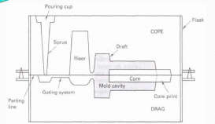
SAND CASTING
Pouring Cup
Flask
COPE
Sprue
R
I
S
E
R
Draft
Draft
Core
Mould cavity
Runner
Core print
Parting line
DRAG
Moulding sand
Sprue base well

Slide 6
SAND CASTING TERMINOLOGY
Flask: A moulding flask is one which holds the sand mould intact. It is made up of wood for temporary applications or metal for long‐term use.
Drag: Lower moulding flask.
Cope: Upper moulding flask.
Cheek : Intermediate moulding flask used in three‐ piece moulding.
Pattern: Pattern is a replica of the final object to be made.
Parting line: This is the dividing line between the two moulding flasks that makes up the sand mould.
Bottom board: This is a board normally made of wood, which is used at the start of the mould making.
Moulding sand: The freshly prepared refractory material used for making the mould cavity. It is a mixture of silica, clay and moisture in appropriate proportions.
Core: Used for making hollow cavities in castings .

Slide 7
Pouring basin: A small funnel‐shaped cavity at the top of the mould into which the molten metal is poured.
Sprue: The passage through which the molten metal from the pouring basin reaches the mould cavity.
Runner: The passage ways in the parting plane through which molten metal flow is regulated before they reach the mould cavity.
Gate: The actual entry point through which molten metal enters the mould cavity in a controlled rate.
Chaplets: Chaplets are used to support cores inside the mould cavity.
Chills: Chills are metallic objects, which are placed in the mould to increase the cooling rate of castings.
Riser: It is a reservoir of molten metal provided in the casting so that hot metal can flow back into the mould cavity when there is a reduction in volume of metal due to solidification.

Slide 8

Steps in Sand Casting
The cavity in the sand mold is formed by packing sand around a pattern, separating themold into two halves • The mold must also contain gating and riser system For internal cavity, a core must be included in mold A new sand mold must be made for each part.
1. Pour molten metal into sand mold
2. Allow metal to solidify
3. Break up the mold to remove casting
4. Clean and inspect casting
5. Heat treatment of casting is sometimes required to
improve metallurgical properties.

Slide 9

Patterns
Patterns are the replica or physical models of the final required shape of the casting, made by wood (teak,magony,pine), plastics, Metals, Plaster of paris etc.,
Types of patterns.
1.Solid pattern
2.Split piece pattern
3.Three piece pattern
4.Loose piece pattern
5.Match plate pattern
6.Segmental pattern
7.Sweep patten
8.skeleton Pattern
9.shell Pattern.

Slide 10

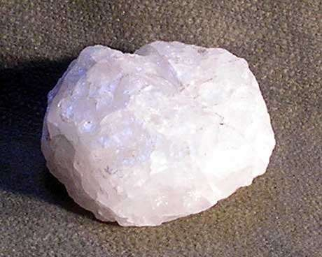
Moulding Sand
Constituents of Moulding Sand
Silica sand grains
80-90% Silicon dioxide
Quartz rock
Imparts refractoriness, chemical resistivity, permeability.
Clay
 5-20%
Bonding Strength
Moisture
 2-8%
Miscellaneous materials
Limestone, magnesia, soda and potash.

Slide 11
Sand animation video link: https://youtu.be/LmjAQGvSrF0

